Slide 1


Green Pace
Security Policy Presentation
Developer: Mary Vuong

Slide 2

OVERVIEW: DEFENSE IN DEPTH
Foundational Principles – The policy is built upon essential security principles such as 'Default Deny' and 'Principle of Least Privilege’.
Coding Standards – Developed to address specific vulnerabilities, including buffer overflows and SQL injections, strengthening system integrity.
Defense in Depth Approach – Serves as a core element of the strategy, aimed at improving security across all operational layers.
Consistent Implementation – Ensures uniform application of security measures across the company's growing number of projects.

Slide 3
THREATS MATRIX
The Threats Matrix categorizes security risks by their likelihood and potential impact, distinguishing between immediate threats and less urgent concerns that require ongoing surveillance.
Automation tools systematically scan code to detect vulnerabilities early in the development cycle. These tools analyze code against known vulnerability signatures to identify potential security issues.
Likely Coding practices prone to human error (e.g., manual data handling and validation). | Priority Threats that could cause data breaches or significant system downtime.
Low priority Issues that are more nuisances than threats, like minor performance inefficiencies. | Unlikely Highly complex attack scenarios that require multiple unlikely failures to succeed.

Slide 4
10 PRINCIPLES
Validate Input Data – String Correctness, SQL Injection
Heed Compiler Warnings – Assertions
Architect and Design for Security Policies – Virtual Function Safety
Keep It Simple – Container Safety
Default Deny – Memory Protection
Adhere to the Principle of Least Privilege – Exceptions
Sanitize Data Sent to Other Systems – Data Value
Practice Defense in Depth – Data Type
Use Effective Quality Assurance Techniques – SQL Injection
Adopt a Secure Coding Standard – All Standards

Slide 5
CODING STANDARDS
Memory Protection – High priority because it addresses the significant risks and common occurrences of memory corruption.
String Correctness – Essential for preventing prevalent and severe issues such as buffer overflows.
Container Safety – High priority due to its role in maintaining data integrity and preventing crashes due to out-of-bounds access.
SQL Injection – A top concern due to its commonality and significant impact on data security, despite not being the most severe.
Assertions – Critical for maintaining program stability by ensuring comprehensive return values in functions.
Data Value – Addresses infrequent but potentially disruptive errors related to improper data handling.
Concurrency Deadlock – Key for ensuring smooth operation in multi-threaded environments, where resource locking must be managed carefully.
Exceptions – Ensuring thorough exception handling is vital for system stability, though such issues occur less frequently.
Virtual Function Safety – Important for maintaining class integrity, particularly in scenarios involving object construction and destruction.
Data Type – Considered lower risk, dealing with issues that generally have a less direct impact on system security.

Slide 6
ENCRYPTION POLICIES
Encryption at Rest – This strategy involves converting stored data into a secure format that cannot be easily interpreted without a decryption key, crucial for protecting sensitive information on devices such as hard drives and mobile devices from unauthorized physical access.
Encryption in Flight – Focuses on securing data as it travels across networks, employing protocols like HTTPS, FTPS, or TLS to encrypt data transmitted between systems, essential for preventing interception and maintaining data privacy.
Encryption in Use – Ensures that data remains encrypted even while being processed by applications, protecting it in environments where data may be exposed to other applications or systems, such as in multi-tenant cloud services or shared platforms.

Slide 7
TRIPLE-A POLICIES
Authentication – Ensures user identity verification through secure mechanisms like passwords and biometrics, essential for establishing controlled access to systems.
Authorization – Defines what resources and operations authenticated users can access, based on roles and responsibilities, extremely important for data protection.
Accounting – Tracks and records user activities to create detailed audit trails, necessary for monitoring, compliance, and security incident response.

Slide 8
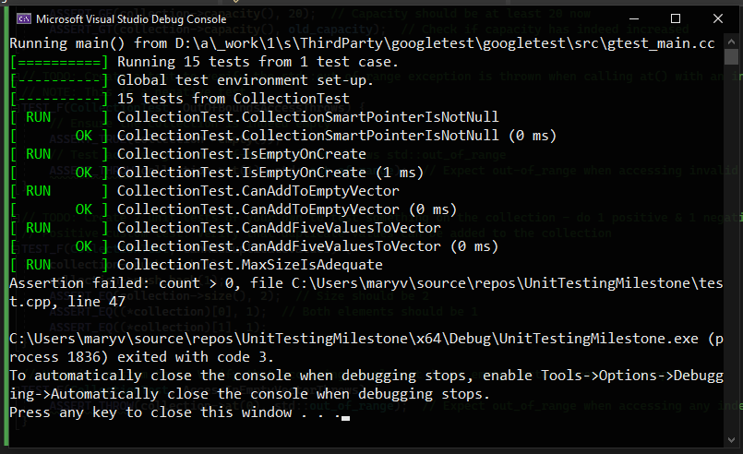
Unit Testing for Vector Management
Vulnerability Tested: Vector Boundary and Capacity Management
Positive Tests:
Add to Empty Vector – Checks adding a single value to an initially empty vector.
Add Five Values – Verifies adding multiple values to ensure vector resizing.
Resizing Increases Collection – Tests that resizing a vector correctly increases its size and capacity.
Negative Tests:
OutOfBounds Access Throws – Confirms accessing an index out of bounds throws std::out_of_range.
Access in Empty Vector Throws – Ensures that attempting to access any element in an empty vector throws an exception.

Slide 9

AUTOMATION SUMMARY
Security Tools:
Design – Applies security best practices and initial security testing.
Pre-production – Conducts vulnerability scanning and source code verification.
Production – Implements continuous monitoring and intrusion detection.
Security Automation Stages:
Build – The compiler enforces secure coding standards.
Pre-production and Production – Features automated security scans and continuous monitoring to detect and manage threats.

Slide 10
TOOLS
DevSecOps Pipeline: Security is integrated from design to deployment. Automation tools enforce adherence to security standards throughout the entire development process.
Tool Integration:
Planning and Design – Static code analyzers proactively identify potential threats.
Build Phase – Automated testing tools continuously check for compliance and expose vulnerabilities.
Deployment – Ansible and similar tools automate the deployment process securely.
Post-Deployment – Splunk and other monitoring tools ensure ongoing surveillance and security.

Slide 11
RISKS AND BENEFITS
Problem: Existing security measures are outdated, increasing vulnerability and exposing Green Pace to potential cyber threats.
Immediate Action Benefits – Quickly improves security and reduces the risk of data breaches.
Immediate Action Risks – Potential for rushed implementations and integration challenges.
Delay Benefits – Allows for more comprehensive planning and phased testing.
Delay Risks – Extended vulnerability period and potential for higher costs due to interim security incidents.
Solutions/Steps: Update security protocols, train staff on new procedures, and integrate advanced monitoring tools.

Slide 12
RECOMMENDATIONS
Addressing security gaps at Green Pace is necessary for improving overall security. By identifying key areas such as outdated measures, inconsistent protocols, and insufficient employee training,, targeted solutions can be developed to strengthen security.
Gaps Identified:
Outdated Security Measures – Current measures are outdated, leaving Green Pace vulnerable to new types of cyber threats. The Zynga data breach in 2019 where over 200 million players were affected (Khandelwal, 2019) is an example of the risks associated with outdated security practices and the need for continuous updates.
Inconsistent Security Protocols – Security protocols are not uniformly applied across all projects. With the Defense in Depth approach, layering security effectively requires consistency across all systems (Fruhlinger, 2022).
Employee Training – Insufficient training on recognizing and mitigating modern security threats. Effective training programs are crucial for maintaining vigilance against potential threats.

Slide 13
CONCLUSIONS
Adopting new standards is important to mitigate future security threats at Green Pace, such as implementing continuous monitoring, conducting regular audits, and new encryption methods.
Adopt New Standards:
Continuous Monitoring – Integrate real-time monitoring tools to detect and respond to threats quickly. The Defense in Depth approach emphasizes the need for ongoing monitoring to mitigate risks effectively.
Regular Security Audits – Conduct frequent audits to ensure compliance and identify vulnerabilities. Regular audits can help prevent incidents by identifying weaknesses before they can be exploited, such as in the Zynga data breach where a hacker gained unauthorized access to a database containing vast amounts of personal information (Khandelwal, 2019).
Enhanced Encryption – Upgrade encryption methods for data at rest, in transit, and in use to protect against advanced threats. Strong encryption policies help safeguard sensitive data.

Slide 14
REFERENCES
Fruhlinger, J. (2022, July 28). Defense in depth explained: Layering tools and processes for better security. CSO Online. https://www.csoonline.com/article/573221/defense-in-depth-explained-layering-tools-and-processes-for-better-security.html
Khandelwal, S. (2019, September 29). Exclusive — Hacker Steals Over 218 Million Zynga “Words with Friends” Gamers Data. The Hacker News. https://thehackernews.com/2019/09/zynga-game-hacking.html

